Slide 1
Data Warehouse
09
Sifat Alamiah Hirarkis (The Nature of Hierrachies Model), Case Study: Retail Sales Hierarchy, Case Study: Sales And Capacity Planning Analysist, DW System Model, Case Study: A Location Specifc Calender
ILMU KOMPUTER
BS
Pembuka
Tombol 05
Tombol 09
Sistem Informasi
Daftar Pustaka
Tombol 06
Tombol 10
Akhiri Presentasi
Tombol 07
Tombol 11
Tombol 04
Tombol 08
Tombol 12

Slide 2
Basis Data Model Hirarki
Model database hirarki (Hierarchical Database Model)
Model database jaringan (Network Database Model)
Model database relasi (Relational Database Model)

Slide 3
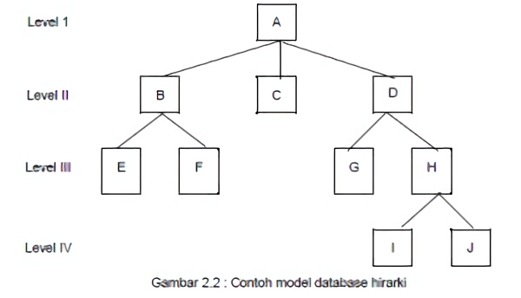
Hierarchical Database Model

Slide 4
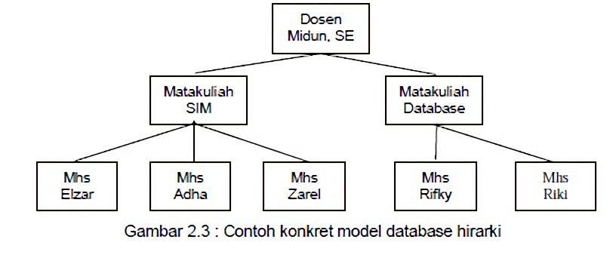
Hierarchical Database Model

Slide 5
Tingkatan Data Dalam Sebuah Hirarki
Bit
Byte
Field
Record
File
Database

Slide 6
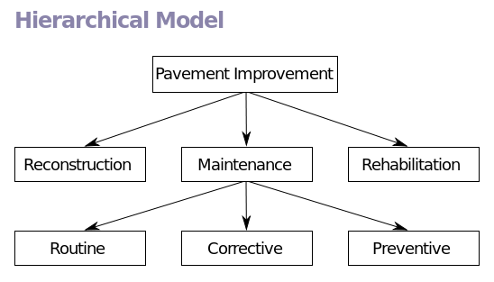
Hirarki Model
Model database hirarki disebut juga model pohon, karena hubungan antar simpul digambarkan seperti struktur pohon (tree-structured) yang dibalik dengan pola hubungan orang tua-anak (parent – child).

Slide 7
Hierarchical Model
Hirarki Struktural
Hirarki Fungsional

Slide 8
Keuntungan Hirarchical Model
Secara konseptual sederhana
Keamanan basis data
Kebebasan data
Integritas basis data
Basis data skala besar lebih efisien

Slide 9
Kimbal, Ralph, 2000, The Data Warehouse Lifecycle Toolkit, New York- USA, Jhon Wiley & Sons, Inc
Todman, Chris.,Designing A Data warehouse, Prentice-Hall, Inc., USA, 2001
Chuck-Ballard, Dirk-Herreman, Don-Schau, Rhonda-Bell, Eunsaeng-Kim, Ann-Valencic, Data Modeling Techniques for Data Warehousing,IBM, 1998

Slide 10
BS

